Slide 1




YOUTUBE CHANNEL PERFORMANCE ANALYSIS
Gateway to Channel Growth
TASK-3
Presented by
Team Lead : Snigdha Gaur
Team Members : Arpita Sharma
Shakthi M
Vishesh Parashar
Team Number
12

Slide 2

Chef Prateek’s
Kitchen channel
Hunt for Food Around the World with us

Slide 3


Objective
01.
Analyzation
Analyze the growth and engagement of the Chef Prateek’s Kitchen Channel
Identification and Suggestion
02.
Identify high performing content and suggesting data driven content strategies
03.
Visualization
Visualize insights using Python Libraries such as, Matplotlib,Seaborn and Power BI

Slide 4
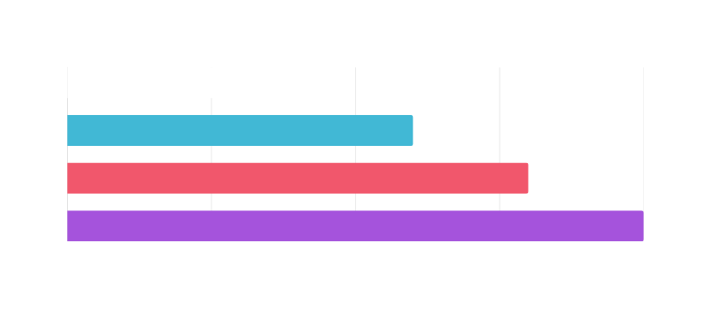

Cleaned Python EDA Notebook
Loading Data → Pandas, read.csv()
Cleaning Data → handling nulls & duplicates
Exploring Data → .describe(), .value_counts
Univariate Analysis → Bar & Line Graph
Multivariate Analysis → Correlation Matrix
Outlier & Anomaly Detection → Isolationforest & IQR
Sentimental Analysis → textblob
SWOT Analysis → tabulate
Visualization → Power BI

Slide 5
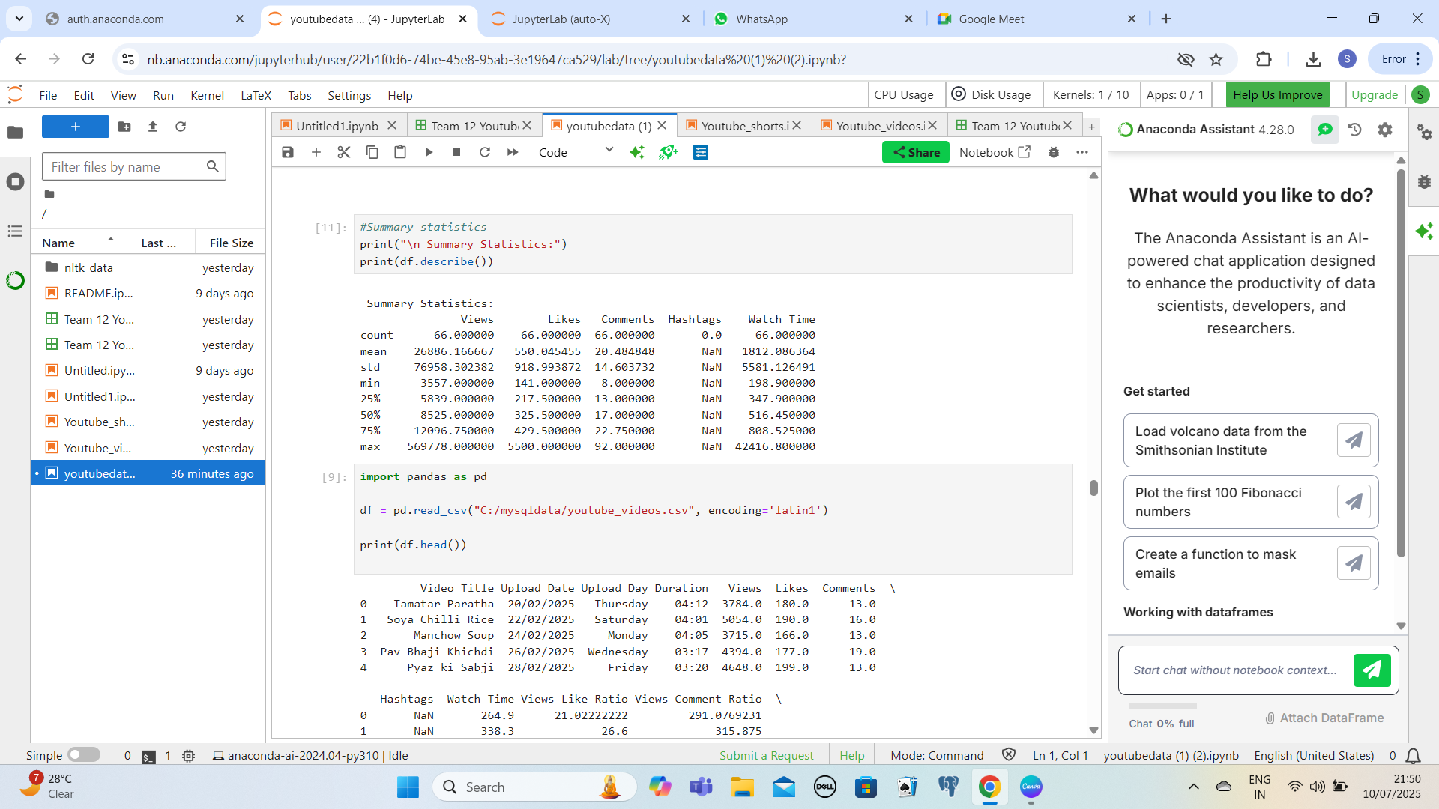
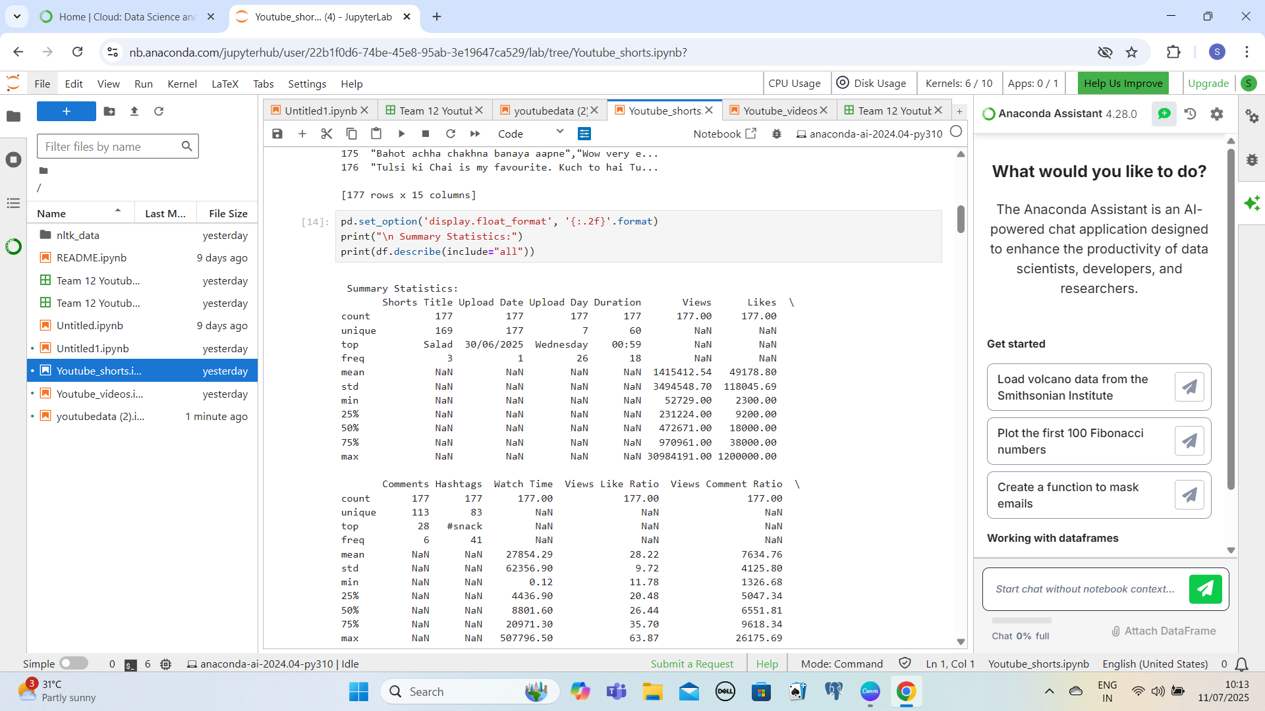
Summary Statistics
Total Video Analyzed : 65
Total Views Analyzed : 65
Total Watch Time Analyzed : 65
Total Comments Analyzed : 65
Total Hashtags Analyzed : 0
Total Shorts Analyzed : 176
Total Views Analyzed: 176
Total Watch Time Analyzed : 176
Total Comments Analyzed : 176
Total Hashtags Analyzed : 176

Slide 6
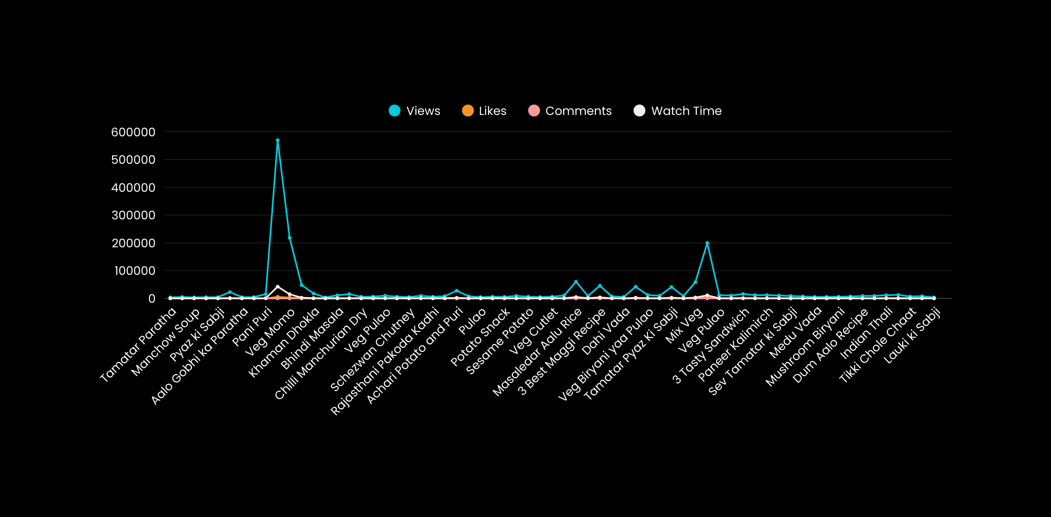

Univariate Analysis of Chef Prateek’s Kitchen Channel’s Videos

Slide 7
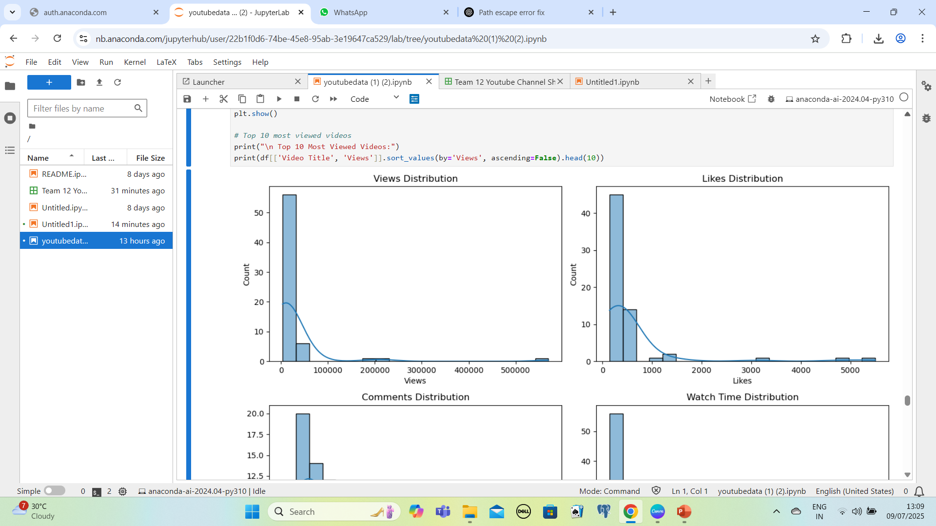
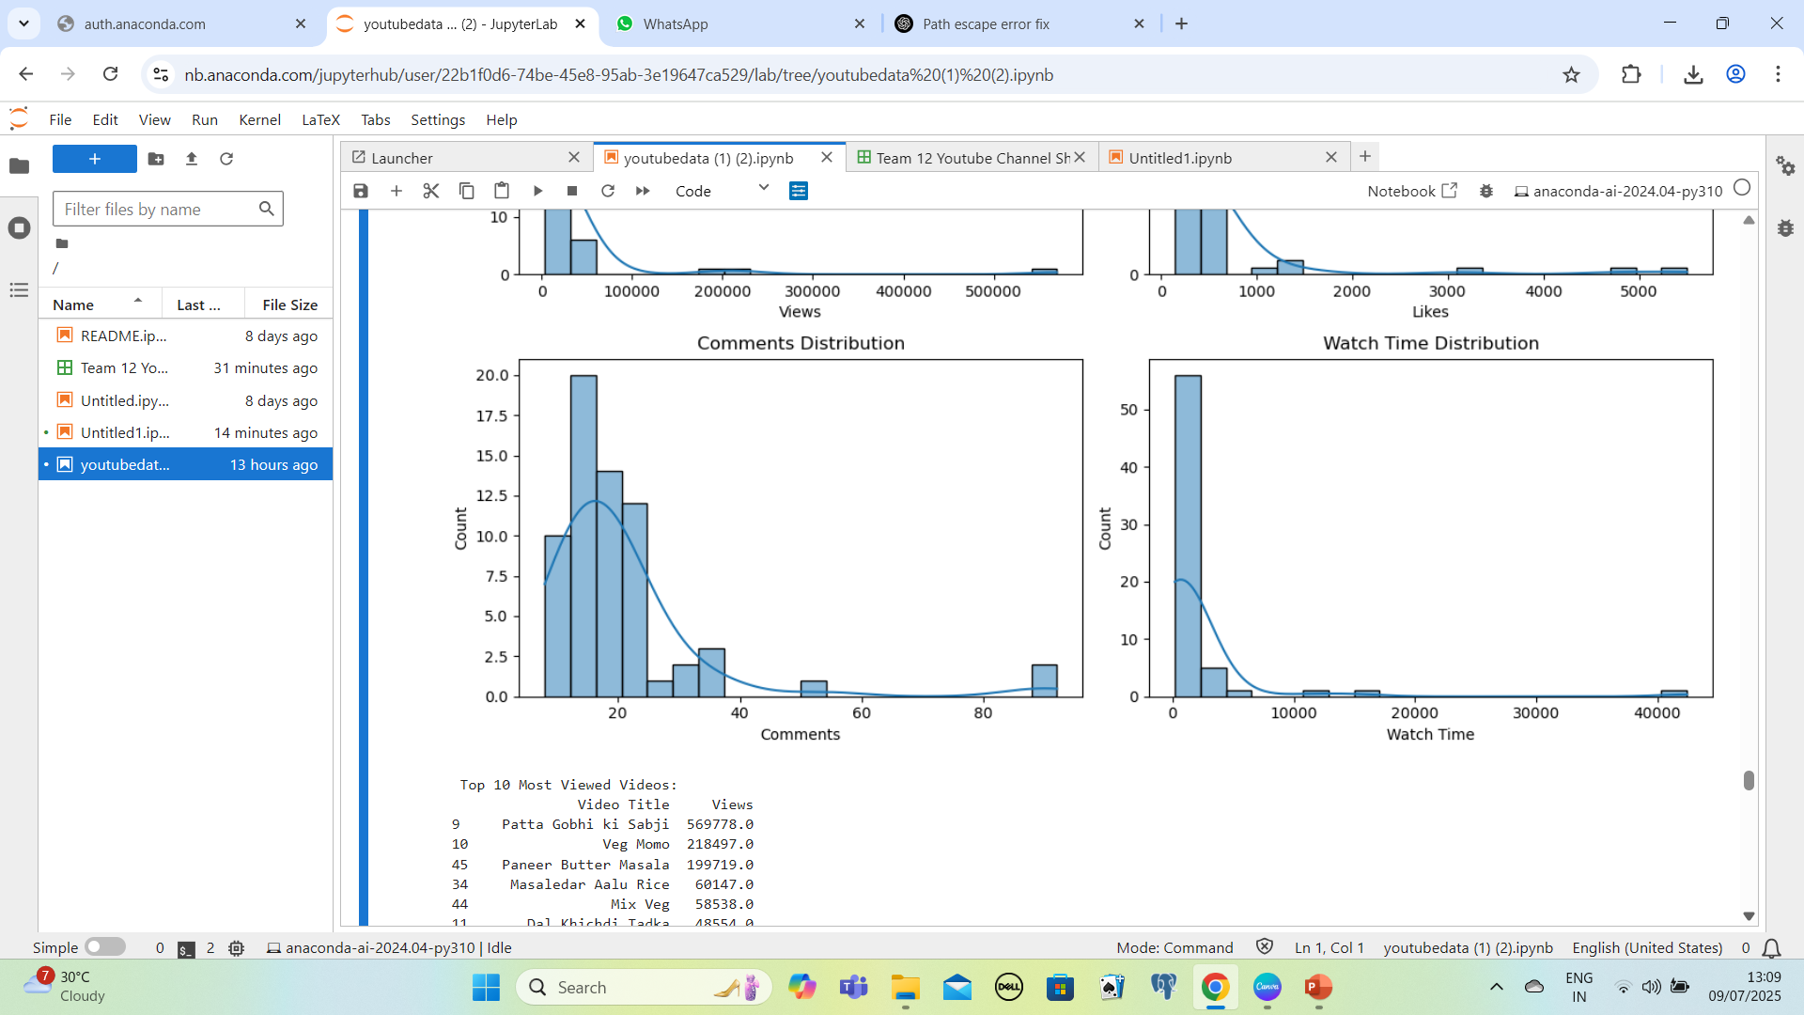

Videos

Slide 8
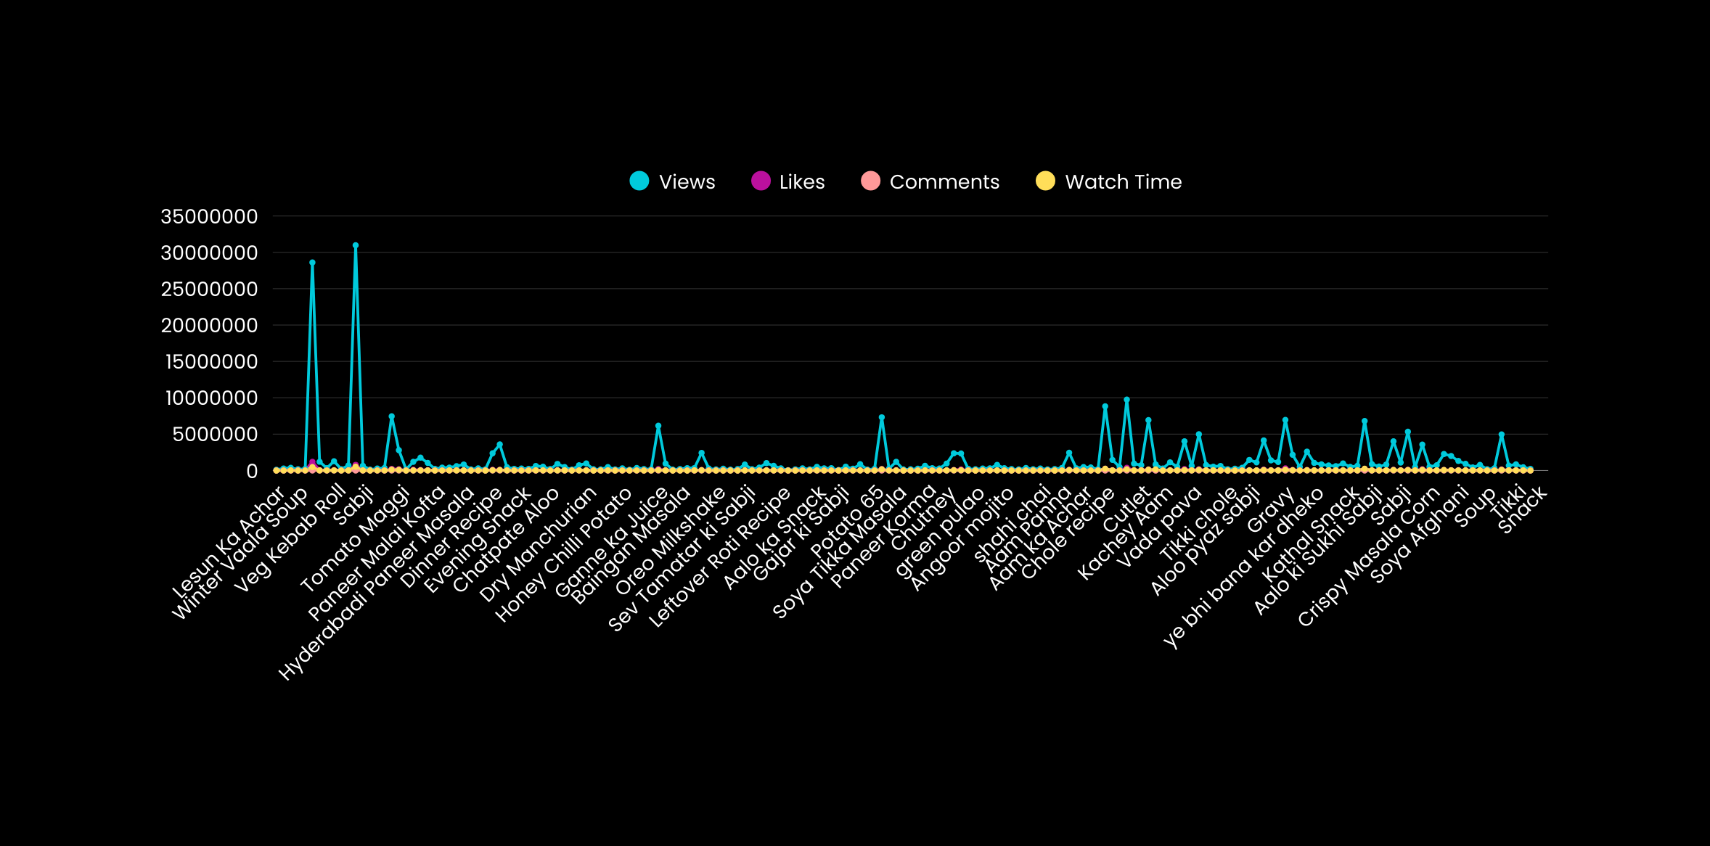
Univariate Analysis of Chef Prateek’s Kitchen Channel’s Shorts

Slide 9
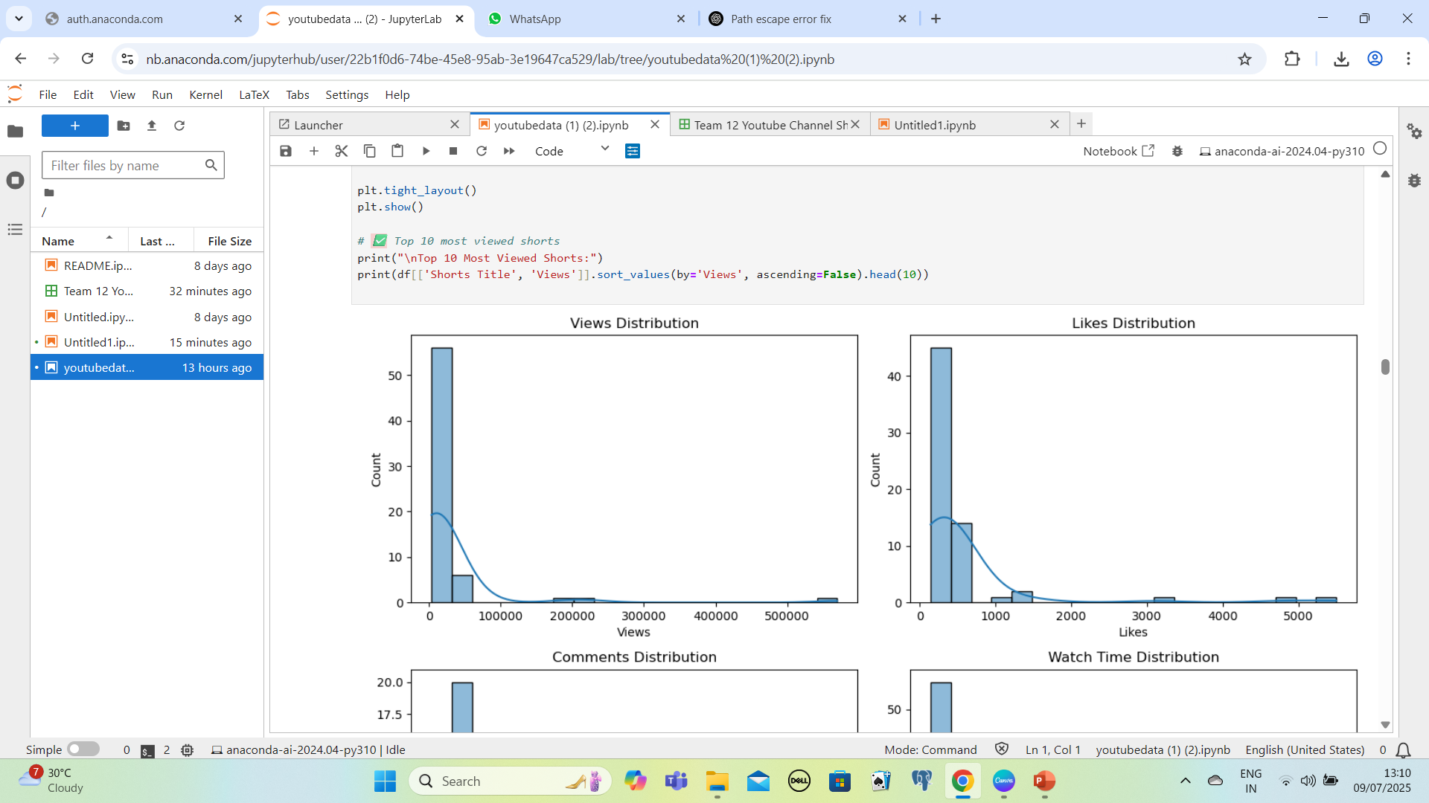
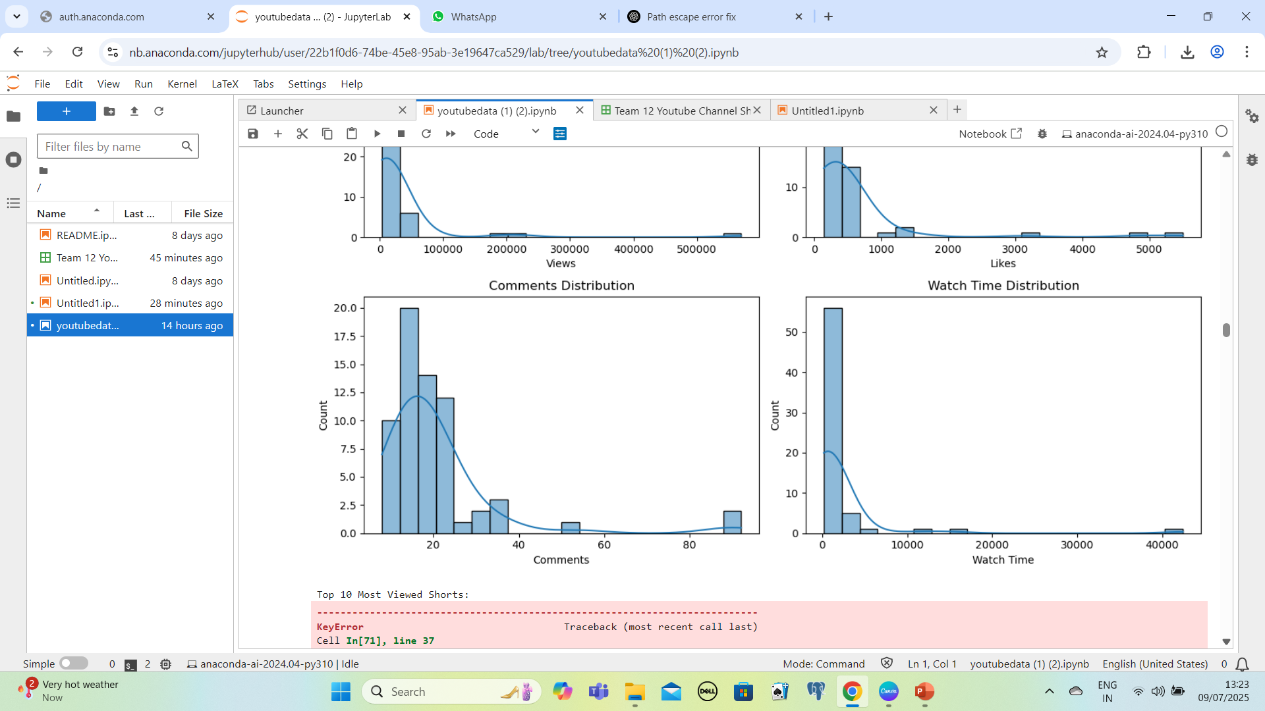
Shorts

Slide 10

Insights & Reasons
Insights
Shorts gain more subscribers
Viewership trends indicate a significant increase in video views during weekends (Saturday and Sunday), suggesting higher audience engagement on non-working days.
Reason
Although full-length videos had higher average watch time, over 60% of new subscribers came from Shorts. This suggests Shorts serve as a strong entry point to attract and convert casual viewers into channel subscribers
Insights
Shorts drive higher likes and comments
The overall sentiment analysis of audience comments indicates a predominantly positive tone, reflecting a strong level of community trust and satisfaction with the channel's content
Reason
Shorts outperform long-form videos in likes and comments due to mobile-first design, scroll behavior, and emotionally driven calls to action. This suggests a content strategy that blends Shorts with targeted engagement hooks can help maximize user interaction.

Slide 11
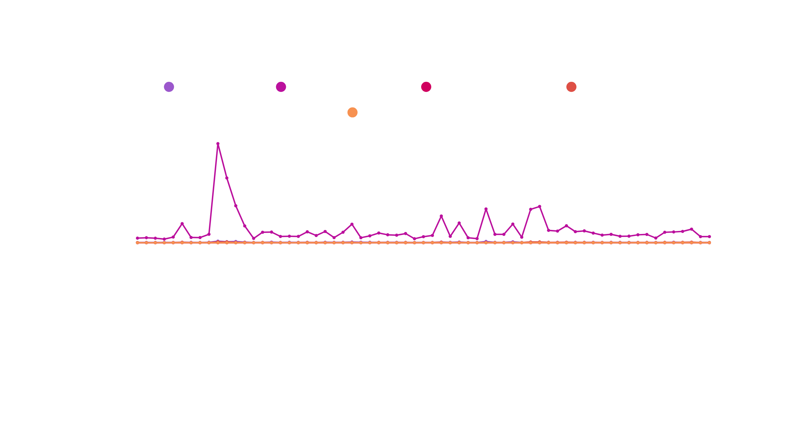
Multivariate Analysis of Chef Prateek’s Kitchen Channel’s Videos

Slide 12
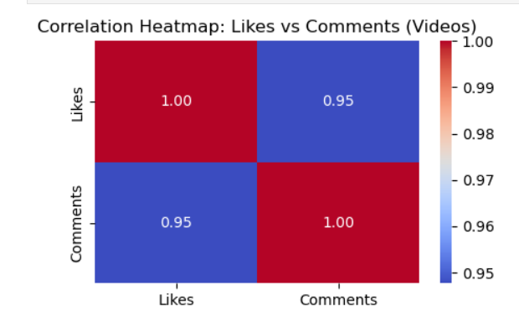
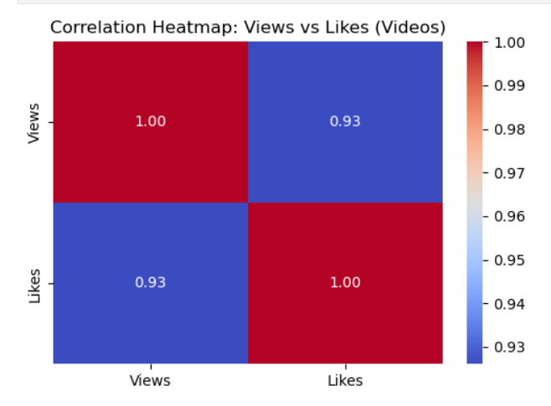
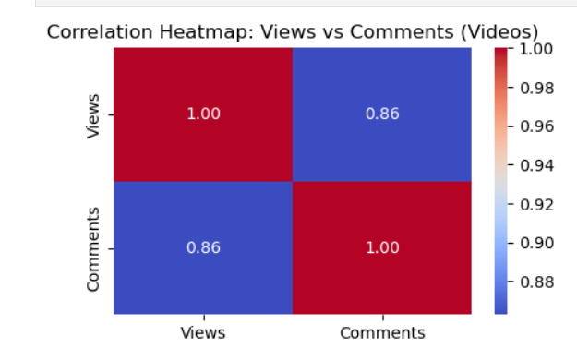
Correlation Heatmaps of Videos

Slide 13
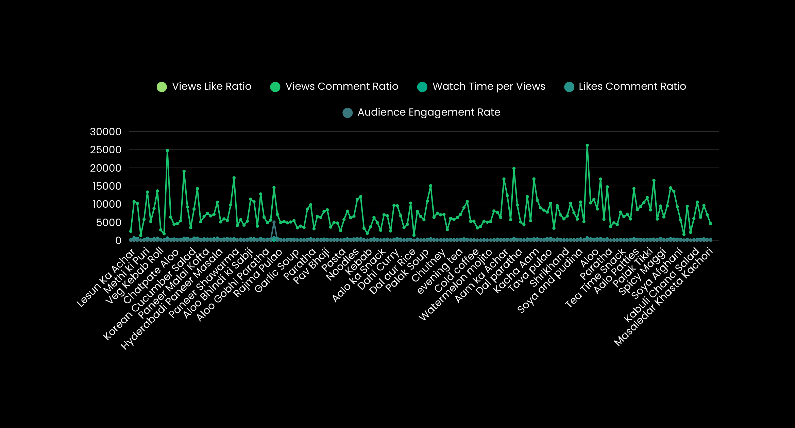
Multivariate Analysis of Chef Prateek’s Kitchen Channel’s Shorts

Slide 14
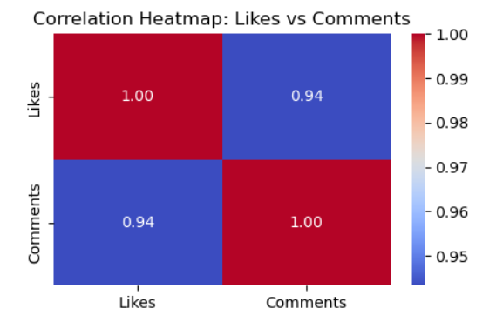
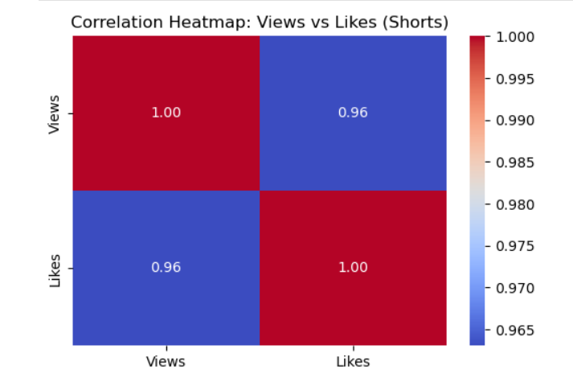
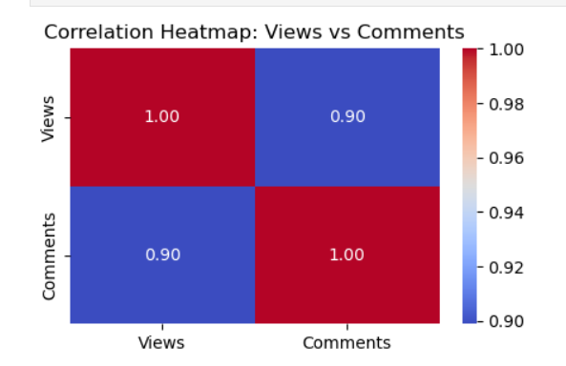
Correlation Heatmaps of Shorts

Slide 15
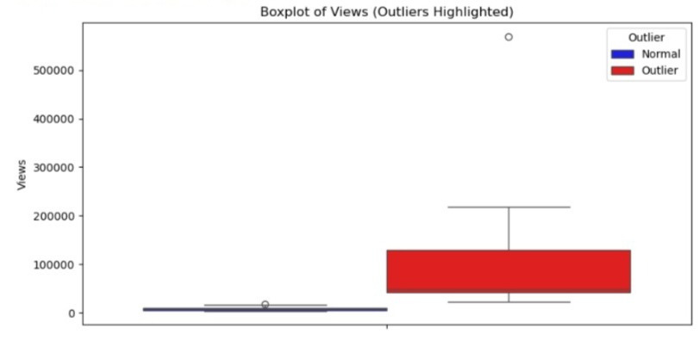
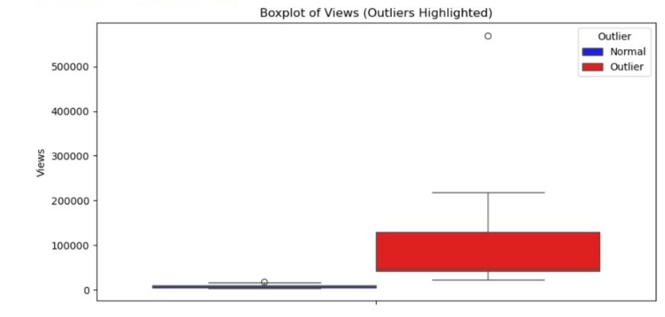
Videos
Outliers
Box Plot
Shorts

Slide 16
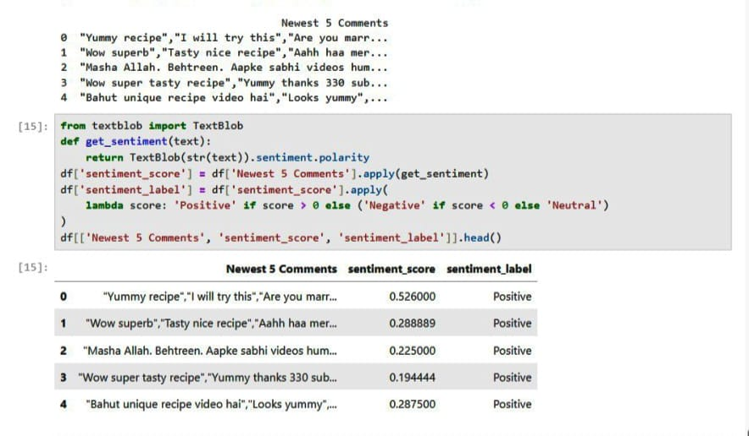
Sentimental Analysis Of Videos
Viewers values depth & tutorial

Slide 17
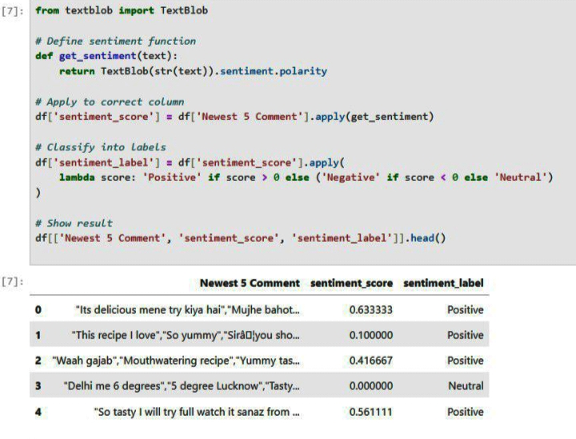
Sentimental Analysis Of Shorts
Viewers enjoy short & eye-catching content

Slide 18

Limited Negative Sentiment
Negative comments were minimal and primarily related to technical aspects such as video clarity, pacing, or recipe explanation and highly oily food content. These isolated cases suggest opportunities for targeted improvements rather than widespread dissatisfaction.
Presence of Neutral Sentiment
A moderate portion of comments were neutral, often consisting of general statements, emojis, or brief expressions like “nice” or “good.” While not highly expressive, these still reflect passive engagement from the audience.
Predominantly Positive Feedback
A substantial majority of the comments reflect positive sentiment, with viewers frequently expressing appreciation for the recipes, presentation style, and overall quality of content. This indicates a high level of audience satisfaction and reinforces the channel’s credibility and trustworthiness.
Negative Comments → ~10%
Neutral Comments → ~15%
Positive Comments → ~75%

Slide 19
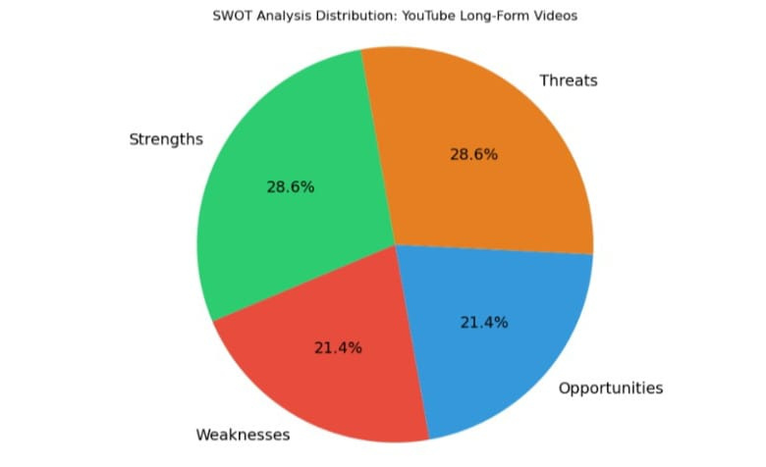
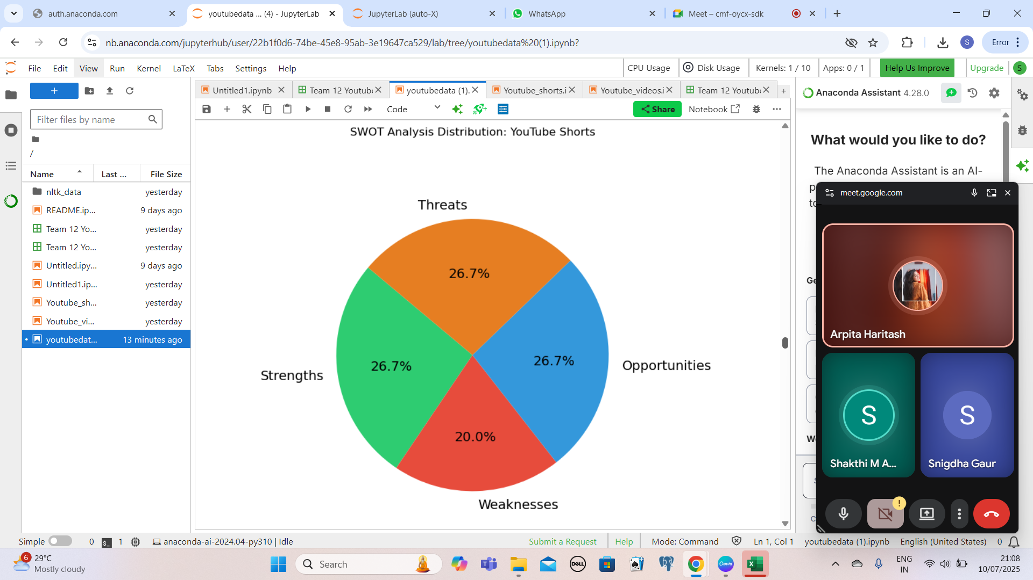
SWOT Analysis
VIDEO’S SWOT ANALYSIS
SHORT’S SWOT ANALYSIS

Slide 20
SWOT ANALYSIS | VIDEOS | SHORTS
STRENGTHS | Videos maintain a consistent viewership and generate strong audience engagement. They receive higher likes and comments per view, reflecting deeper viewer interaction. | Shorts drive significant views and are effective in reaching a broader audience.They contribute heavily to subscriber growth due to their algorithmic reach.
WEAKNESS | The channel has limited viral content and less variety in formats.Viewer interaction (comments) on some videos remains relatively low. | Limited engagement in the form of likes and comments compared to videos.Lack of instructional depth may affect content value over time.
OPPORTUNITIES | There is room to introduce new formats like collaborations, recipe series, or tutorials.Enhancing metadata (titles, thumbnails) can improve discoverability. | The channel can expand Shorts content by leveraging trends and seasonal recipes.Cross-platform promotion (e.g., Instagram Reels) can further amplify reach.
THREATS | The channel faces increasing competition in the culinary content space.Potential algorithm changes or platform policies may impact video visibility | Shorts engagement is often shallow, with fewer comments and viewer feedback.The short-form content space is highly saturated, increasing competition

Slide 21

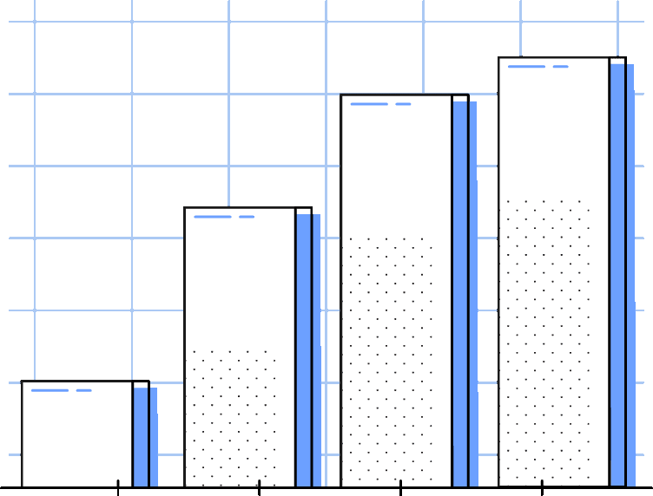

Power BI Visualization
Dasboard

Slide 22


Category
Videos
Shorts
Content Length | 5-15 Minutes | Under 60 Seconds
Watch Time | Longer videos but often low retention | Short total duration, high completion rate
Reach & Algorithm Boost | Moderate → Needs search or subscription | High → Mobile optimized, visible shorts shelf
Outlier Detection (IF & IQR) | More consistent, fewer anomalies | More performance extremes found
Subscriber Gain & Engagement Rate | Steady increase overtime & Lower engagement per view | Fast subscriber growth & High likes\comments per view

Slide 23
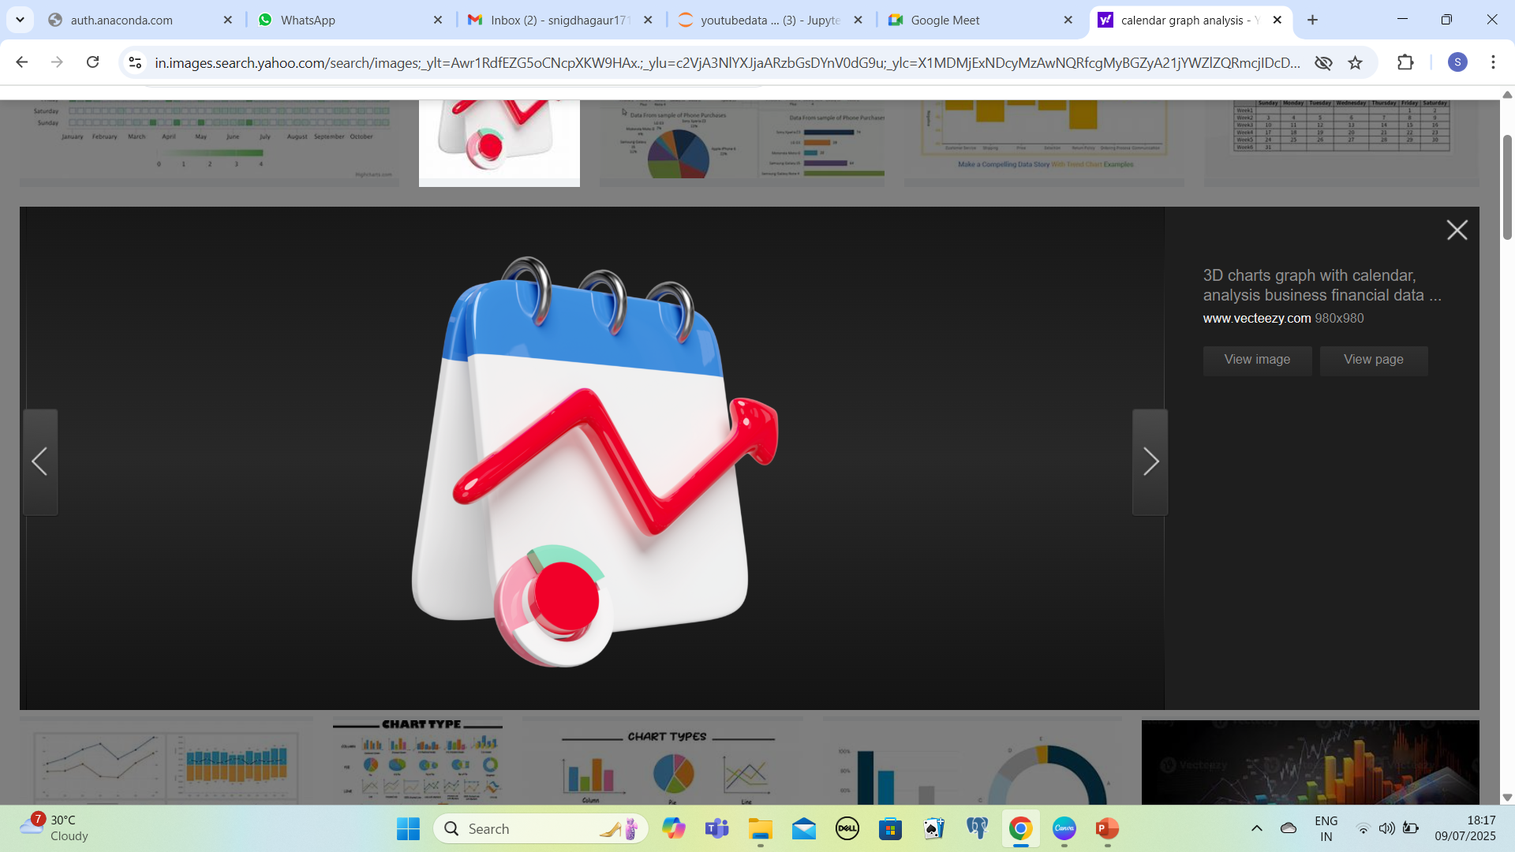

The best time to upload is “Weekends”
The next best is a “Day Before Holidays”!!!!
Thankyou

